Slide 1

A Deepdive on STEM Salaries
By Connor Grant, Alfredo Garcia, Yousuf Amin AlFatwa & Neel Patel

Slide 2
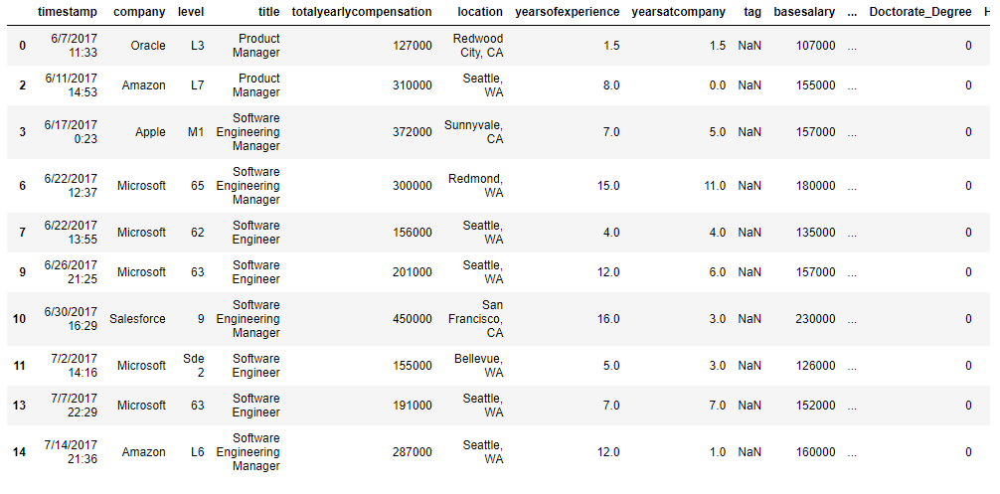
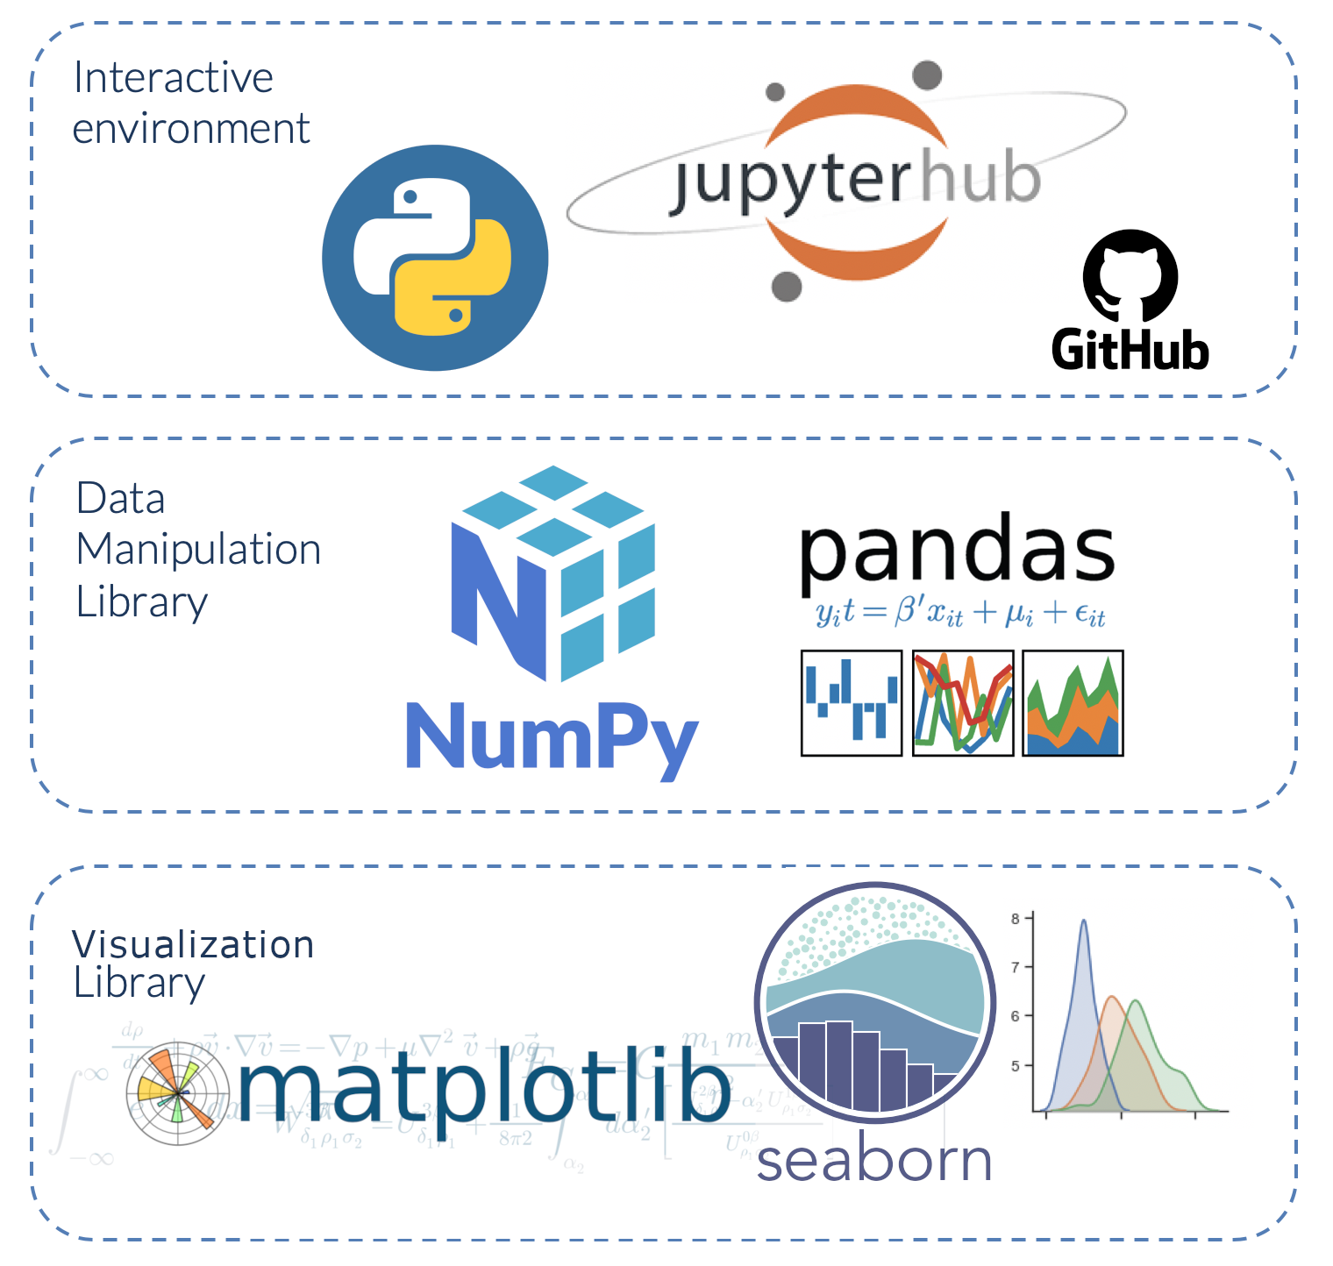
About Dataset (STEM = Science, Technology, Engineering, and Mathematics)
Kaggle: https://www.kaggle.com/datasets/jackogozaly/data-science-and-stem-salaries
This Dataset contains data about STEM jobs, job title, location, salaries (base salary, bonus, stock grants), education level, experience, employees race and gender.
Analyzed 62,642 rows and 29 columns

Slide 3
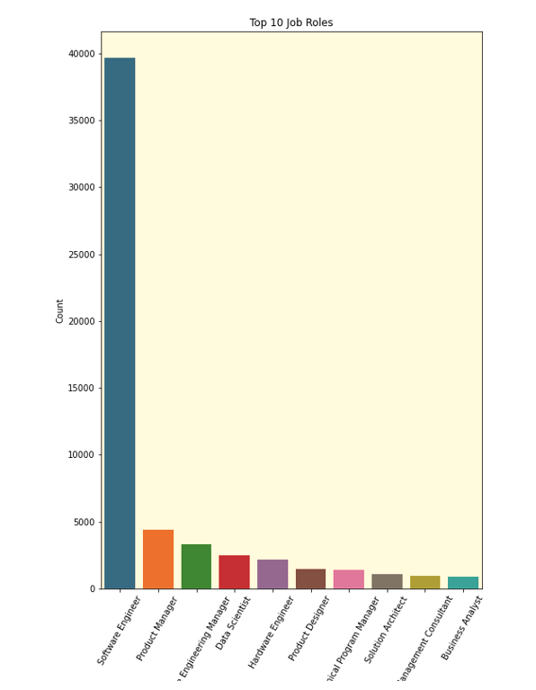

Exploring the data: Top 10 Job Roles Found
-Using cleaned data frame that removed any base salary counts of zero, a new data frame was built, using a top 10 count of job “title”. This allowed us to find which jobs appeared the most within our data.
-Based off these findings, we’re able to see that “Software Engineers” are in high demand! We can also assess that “data scientist” and “business analyst” also are within the top 10, which is a nice reassurance for us in the Bootcamp that upon graduation, we could be seeing a nice demand for our role/skill set in the job search.
-Results could vary slightly if the above steps were not taken to make a refined data set to work with.
Listed: Software Engineer, Product Manager, Software Engineering Manager, Data Scientist, Hardware Engineer, Product Designer, Technical Program Manager, Solution Architect, Management Consultant, Business Analyst
-Using a year count for job titles that fell under “business analyst” and/or “data scientist”, we were able to find that there is significant growth of these roles from 2018 to 2021

Slide 4
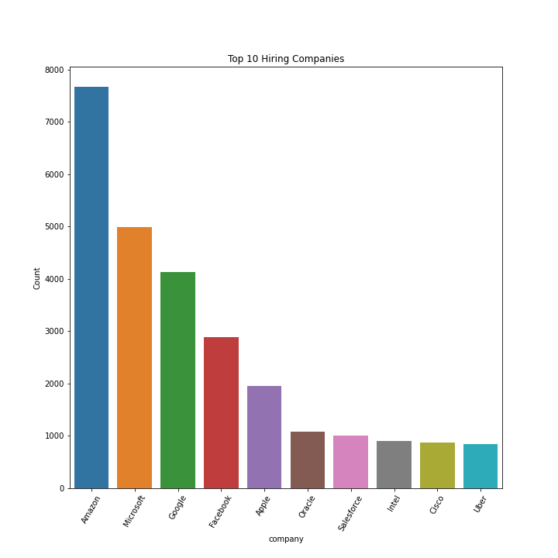
Exploring the data: Top 10 Companies Found
-Using cleaned data frame that removed any base salary counts of zero, a new data frame was built, using a top 10 count of “company”.
-This allowed us to find which companies appeared the most within our data, and could be a further means of interest in seeing which roles these companies are hiring for if they are relevant to our skills.
-Results could vary slightly if the above steps were not taken to make a refined data set to work with.

Slide 5
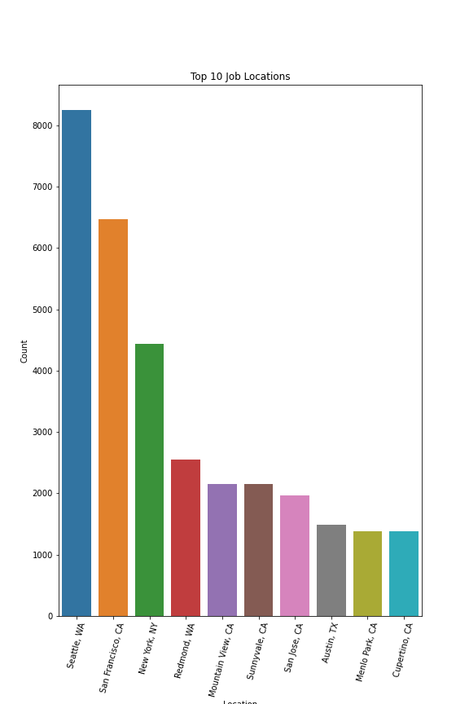
Exploring the data: Top 10 Locations Found
-Using cleaned data frame that removed any base salary counts of zero, a new data frame was built, using a top 10 count of “location”.
-This allowed us to find the most common job locations within this data.
-Results could vary slightly if the above steps were not taken to make a refined data set to work with.
Other areas to explore for future study: Base salaries of each company, breakdown comparisons of top 5 companies where we can examine/compare stock options provided, bonus options provided, and account these factors within their total yearly salary to see which company and role pays the “best”.

Slide 6
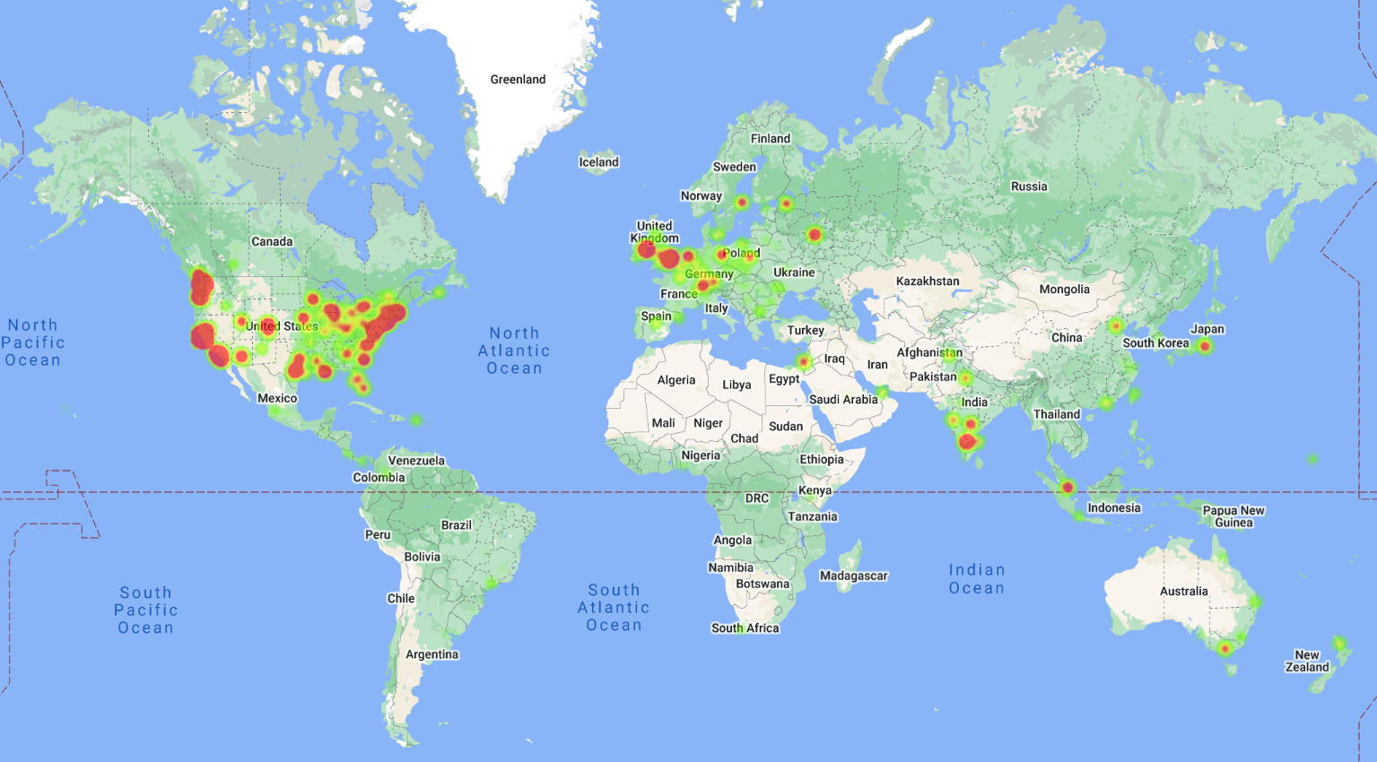
STEM Jobs Distribution in The World

Slide 7
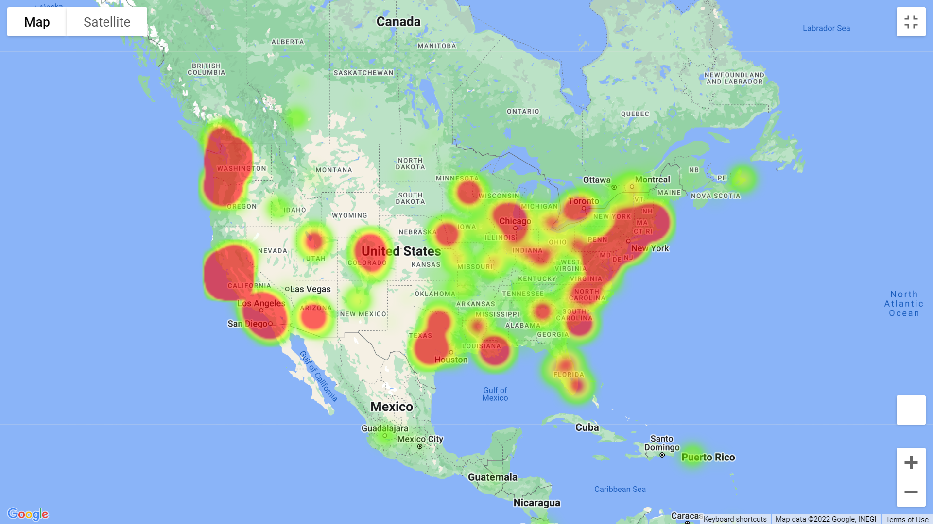
STEM Jobs Distribution in The USA

Slide 8
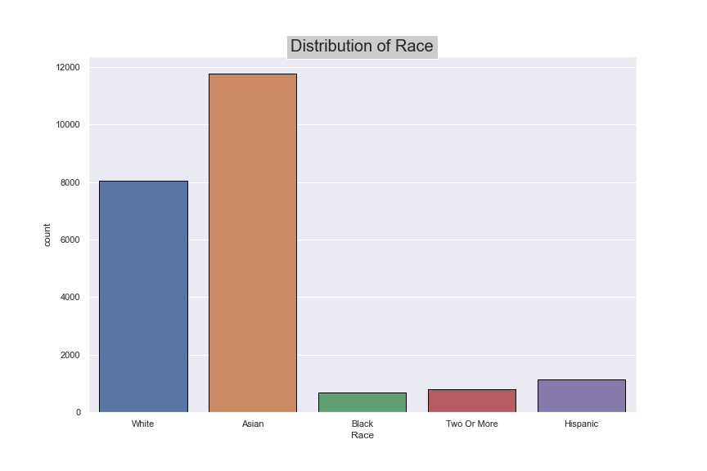
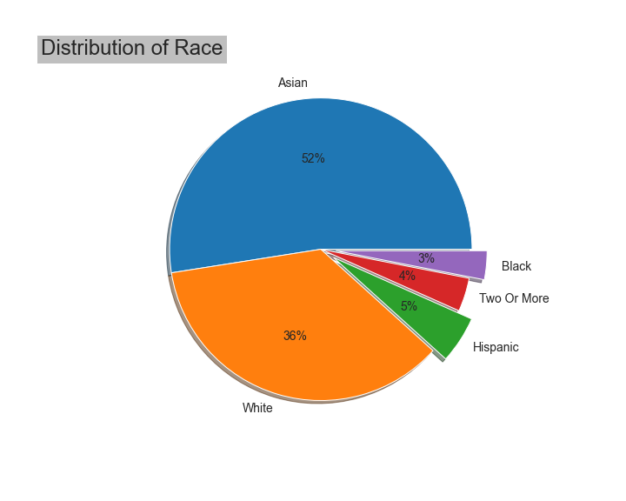
Distribution of race in jobs
Notes:
insourcing and outsourcing
and market need from local university

Slide 9
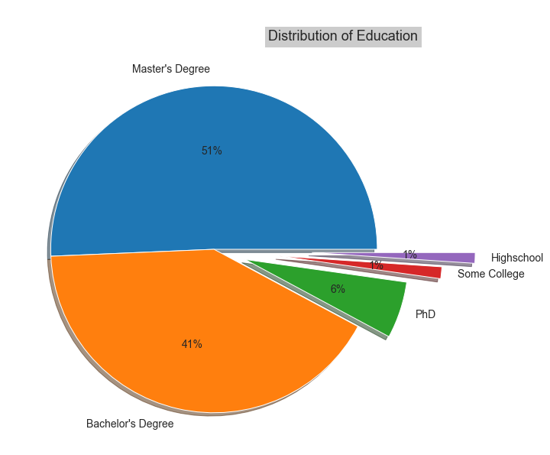
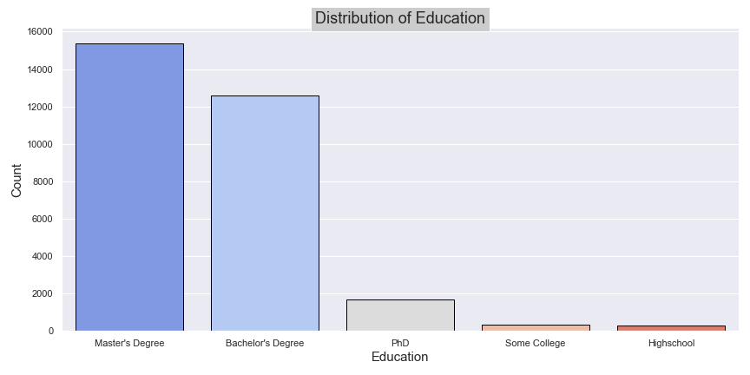
Relation Between Education Degree And Job Count
Work experience can make you a good match for a particular job, but you may lack the essential skills for advancement tomorrow without higher education.

Slide 10
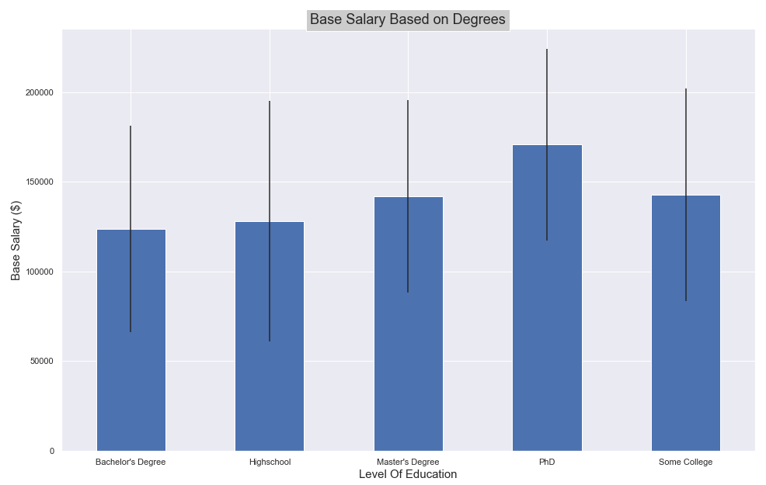
Base Salary Based on Education Level
Most of the people working in STEM and Data Science have a Master's Degree.
More education often leads to better job stability and pay.

Slide 11
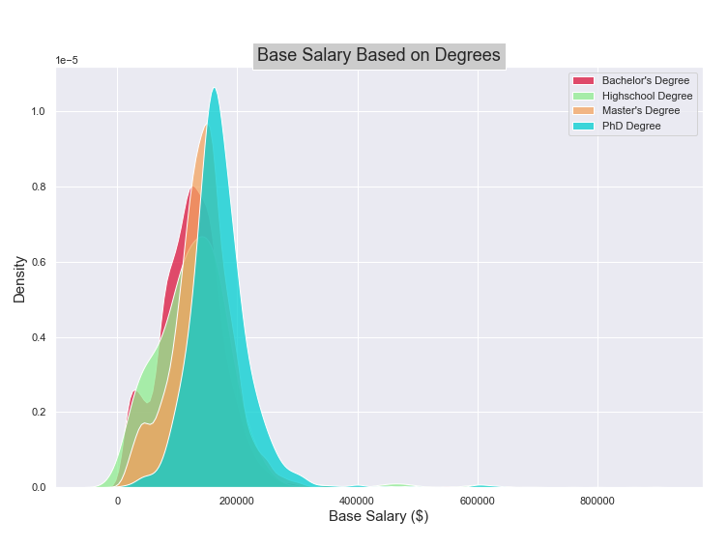
Base Salary Based on Education Level
Is Ph.D Degree Worth it?
Educational attainment and income are closely correlated, with higher degrees typically leading to higher salaries.

Slide 12
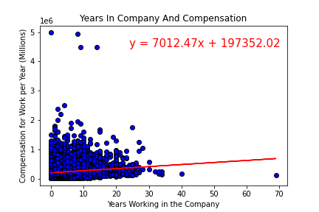
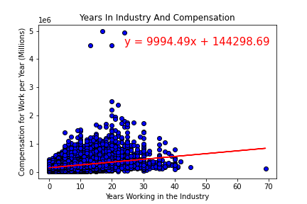
Time In Tech Industry/ Company Vs Pay
-Working in the industry increases faster than working in a company does.
-Companies seem to have higher start pay than working in the industry.
-Outliers may skew the data more than expected.

Slide 13
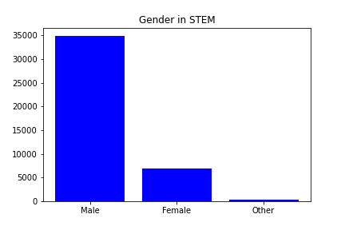
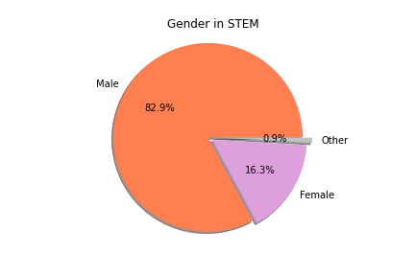
Gender in STEM
Dataset indicated 5 categories for genders: “Female” (6,999), “Male” (35,702), “NA” (19,540), “Other” (400), “Title: Senior Software Engineer” (1)
Removed “NA” and “Title: Senior Software Engineer” and base salary of $0.
STEM Jobs are heavily dominated by Male.
The biggest hurdle is incomplete data which does not give us the full view of gender in STEM roles.
There is a big gap between Male and Female in STEM roles but that gap will be closed in the future as we can see more Female in STEM roles.

Slide 14
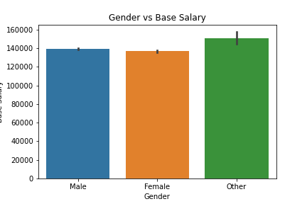
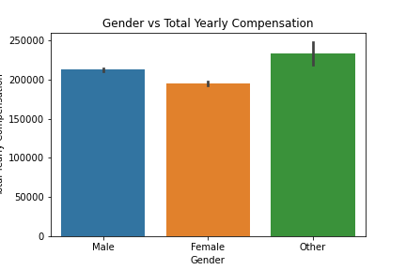
Gender vs Base Salary / Total Yearly Compensation
Annual salaries between Males and Females are similar.
Due to incomplete data, it would be great to see which gender the “Other category is. Once that is defined it can give us a better picture.
This dataset covers STEM Jobs from 2017 to 2021. STEM jobs have increased from 2019-2021 and more Females have been hired in those 2 years than Males.
A prediction can be made that in the future the gap between Males/Females salaries will be narrowed.

Slide 15
Summary
This data concludes that Amazon is the biggest employer of STEM. Software Engineers the most common STEM job. Seattle, Washington is the most common location for most STEM jobs.
STEM Jobs have been increasing in the past 2 years and is expected to keep growing.
STEM sector gets bigger and bigger, more specialists with higher education are helpful.
Most of the people working in STEM and Data Science have a Master's Degree, followed by a Bachelor's Degree.
Race: Asian has a Dominance in Race Factor.
Gender does not have an impact on average salary in STEM. But there are more Males employed than Females.
If we had more time, we could have done a more deep dive with which company offers the most money, stock options, bonuses.
Cleaning this dataset was required as there was a lot of missing data and it caused biased results.

Slide 16

THANK YOU

